Slide 1
Generative Models Discriminative vs Generative
Understanding Machine Learning

Slide 2
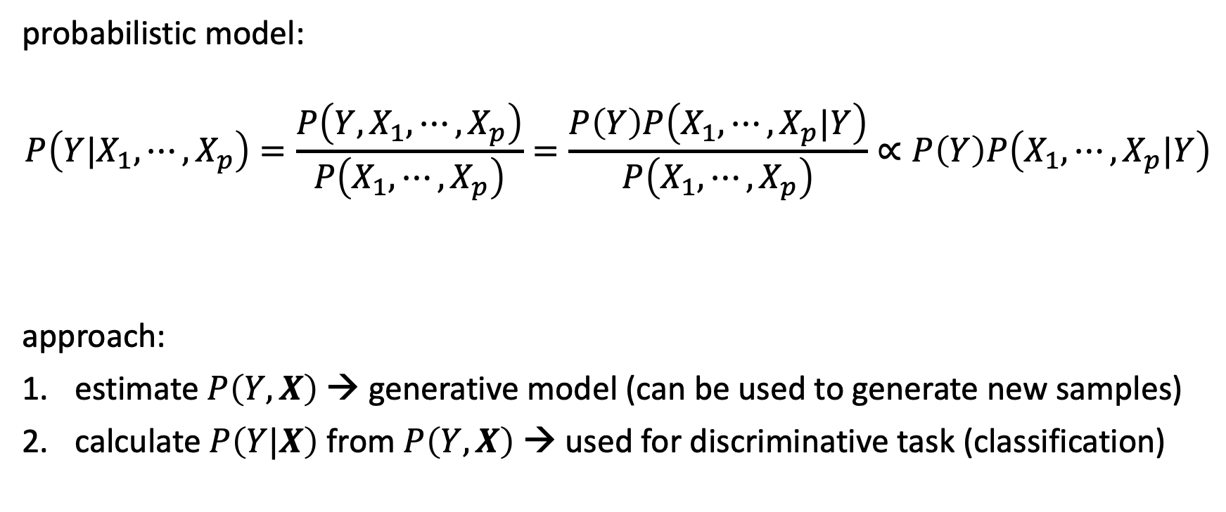
Archetype: Naïve Bayes
probabilistic model:
$$P\left(Y|X_{1}, ⋯,X_{p}\right)=\frac{P\left({Y,X}_{1}, ⋯,X_{p}\right)}{P\left(X_{1}, ⋯,X_{p}\right)}=\frac{P\left(Y\right)P\left(X_{1}, ⋯,X_{p}|Y\right)}{P\left(X_{1}, ⋯,X_{p}\right)}∝P\left(Y\right)P\left(X_{1}, ⋯,X_{p}|Y\right)$$
approach:
estimate $P\left(Y,X\right)$ → generative model (can be used to generate new samples)
calculate $P\left(Y|X\right)$ from $P\left(Y,X\right)$ → used for discriminative task (classification)
Bayes’ rule
constant
to be estimated

Slide 3

Independence Assumption
(naïve) assumption: conditional independence of features given target
$$P\left(X_{j}|Y,X_{1},{⋯,X}_{j−1},X_{j+1},⋯,X_{p}\right)=P\left(X_{j}|Y\right)$$
$$⟹P\left(Y|X_{1}, ⋯,X_{p}\right)=\frac{P\left(Y\right)\prod_{j=1}^{p}{P\left(X_{j}|Y\right)}}{P\left(X_{1},⋯,X_{p}\right)}$$
→ independent feature contributions (ignoring feature correlations)
→ robust against curse of dimensionality

Slide 4

Estimation of Feature Contributions
separate estimations of $P\left(X_{j}|Y\right)$ for each feature
requires assumption of distributions (e.g., Gaussian naïve Bayes) or non-parametric methods (kernel density estimation)
$P\left(x_{ij}|y\right)=\frac{1}{\sqrt{2πσ_{y,j}^{2}}}\exp\left(−\frac{{\left(x_{ij}−μ_{y,j}\right)}^{2}}{2σ_{y,j}^{2}}\right)$
parameter estimation (e.g., mean and variance of Gaussians) can be done with maximum likelihood method ($y$ known in training)
→ no Bayesian methods needed
Gaussian feature likelihoods:

Slide 5
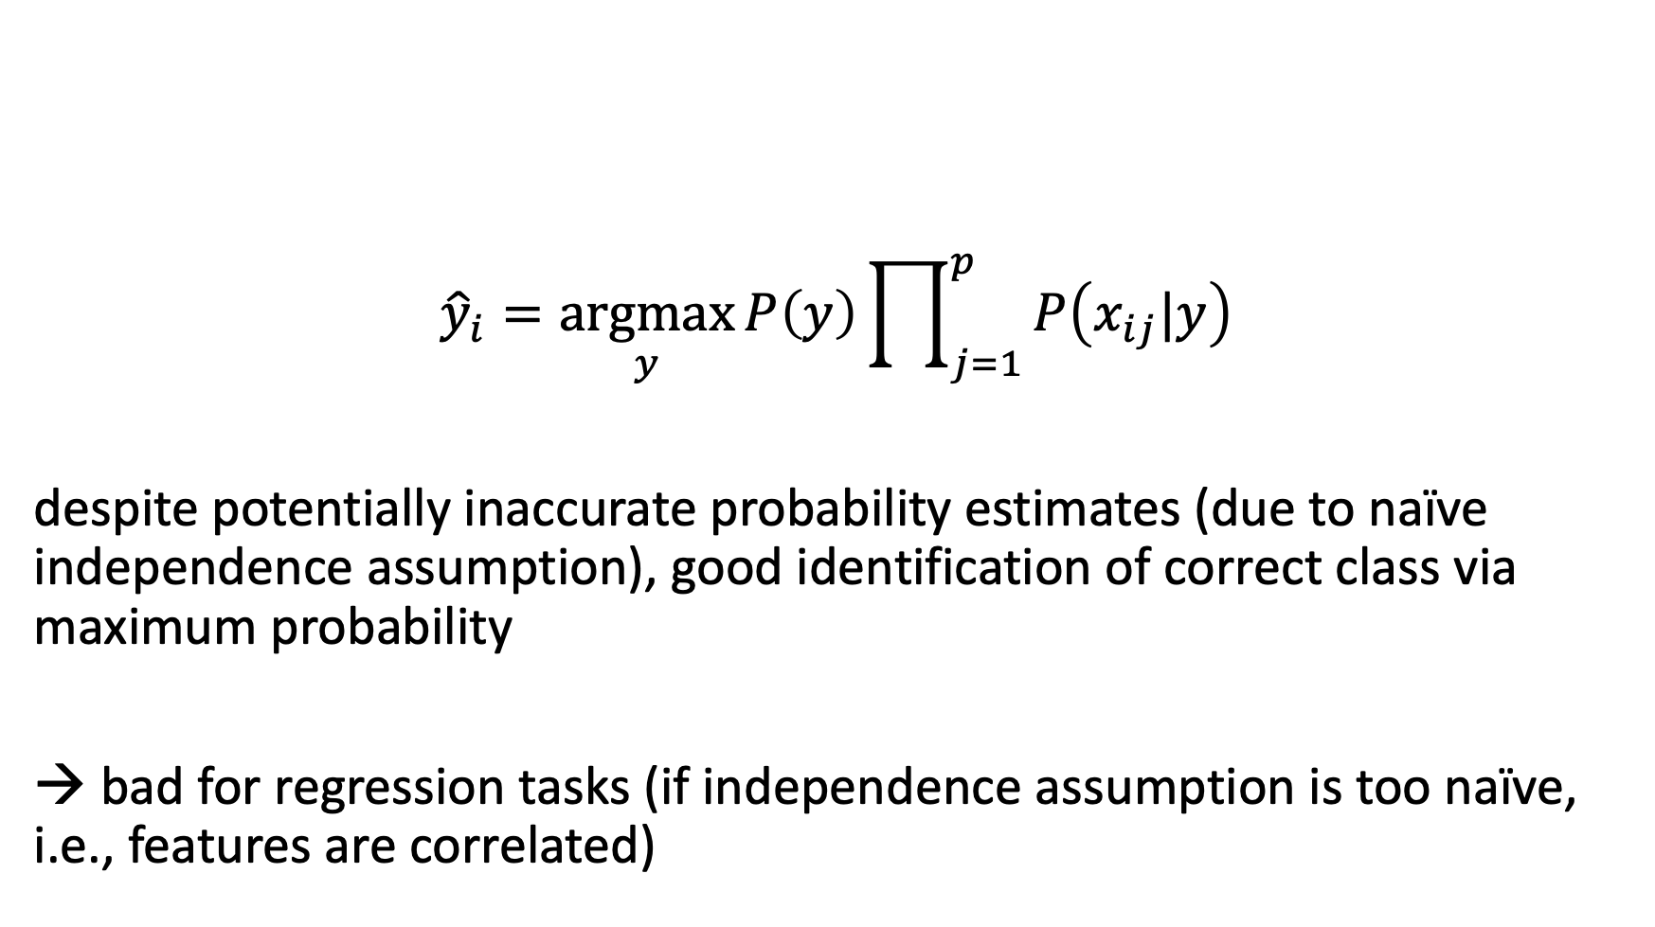
Maximum a Posteriori Classification
$${\hat{y}}_{i}=\underset{y}{argmax}{P\left(y\right)\prod_{j=1}^{p}{P\left(x_{ij}|y\right)}}$$
despite potentially inaccurate probability estimates (due to naïve independence assumption), good identification of correct class via maximum probability
→ bad for regression tasks (if independence assumption is too naïve, i.e., features are correlated)

Slide 6

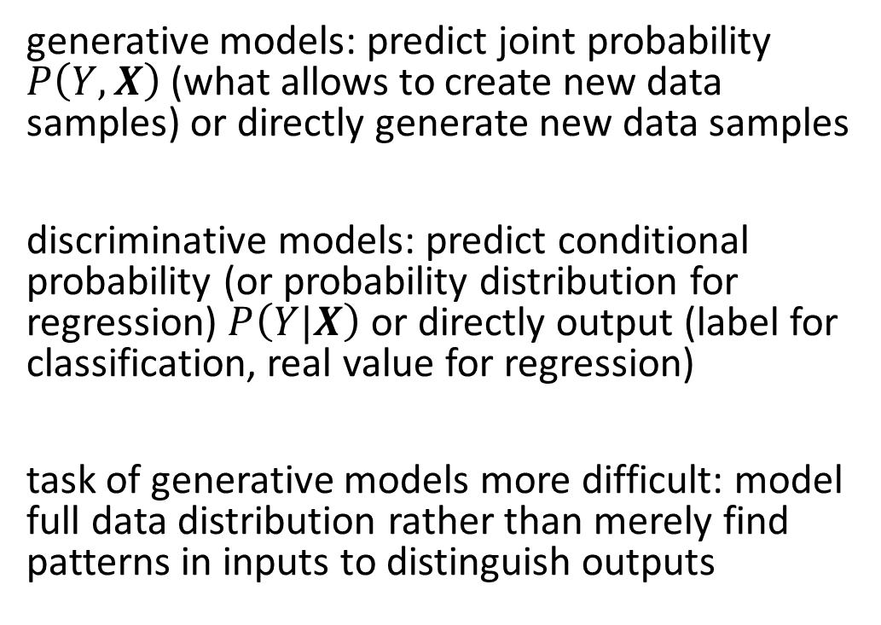
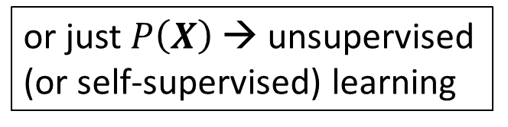
Generative vs Discriminative Models
or just $P\left(X\right)$ → unsupervised (or self-supervised) learning
generative models: predict joint probability $P\left(Y,X\right)$ (what allows to create new data samples) or directly generate new data samples
discriminative models: predict conditional probability (or probability distribution for regression) $P\left(Y|X\right)$ or directly output (label for classification, real value for regression)
task of generative models more difficult: model full data distribution rather than merely find patterns in inputs to distinguish outputs
discriminative model
generative model
source

Slide 7
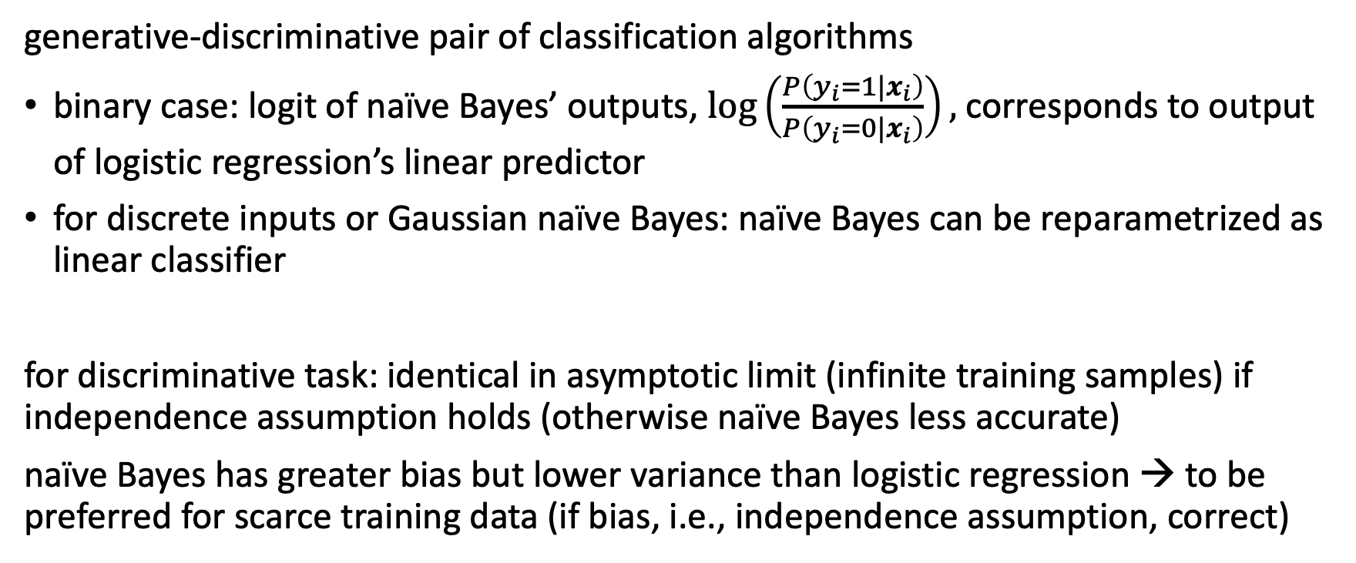
Naïve Bayes and Logistic Regression
generative-discriminative pair of classification algorithms
binary case: logit of naïve Bayes’ outputs, $\log\left(\frac{P\left(y_{i}=1|x_{i}\right)}{P\left(y_{i}=0|x_{i}\right)}\right),$ corresponds to output of logistic regression’s linear predictor
for discrete inputs or Gaussian naïve Bayes: naïve Bayes can be reparametrized as linear classifier
for discriminative task: identical in asymptotic limit (infinite training samples) if independence assumption holds (otherwise naïve Bayes less accurate)
naïve Bayes has greater bias but lower variance than logistic regression → to be preferred for scarce training data (if bias, i.e., independence assumption, correct)

Slide 8
Data Generation
generative models can be used for discriminative tasks (although potentially inferior to direct discriminative methods)
but generative methods do more than discriminative ones: model full data distribution
→ allows generation of new data samples (can be images, text, video, audio, code like SQL or Python, proteins, materials, time series, structured data, …)
large (auto-regressive) language models examples of generative models

Slide 9
Generative AI
Depending on the application, there are currently two dominant approaches for generative AI:
text generation: LLMs
image synthesis: diffusion models

Slide 10

Image Synthesis
example: DALL-E 2
idea: generate new images as variations of training data
condition generation on text prompts: text-to-image
trade-off between diversity and fidelity
SOTA: (guided) diffusion models

Slide 11

Different Types of Generative Models
two neural networks playing a zero-sum game
learn variational distribution (not just replicating inputs)
more complex distributions by applying change-of-variable technique (need for specialized architecture)
chain of denoising autoencoders
source

Slide 12
Generative Adversarial Networks (GAN)

Slide 13
Indirect Training via Discriminator
two neural networks playing a zero-sum game:
the generator network G generating new (fake) samples
the discriminator network D trying to distinguish between real and fake samples
idea: G not trained directly to minimize reconstruction error of real samples, but to fool D → self-supervised approach

Slide 14

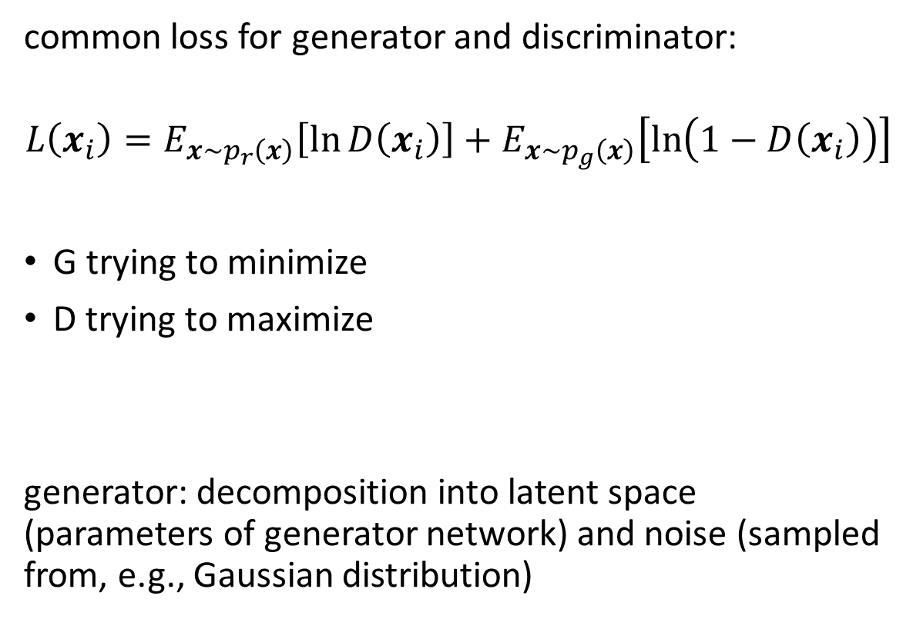
Formulation
common loss for generator and discriminator:
$$L\left(x_{i}\right)=E_{x\sim p_{r}\left(x\right)}\left[\ln{D\left(x_{i}\right)}\right]+E_{x\sim p_{g}\left(x\right)}\left[\ln\left(1−D\left(x_{i}\right)\right)\right]$$
G trying to minimize
D trying to maximize
generator: decomposition into latent space (parameters of generator network) and noise (sampled from, e.g., Gaussian distribution)
source

Slide 15
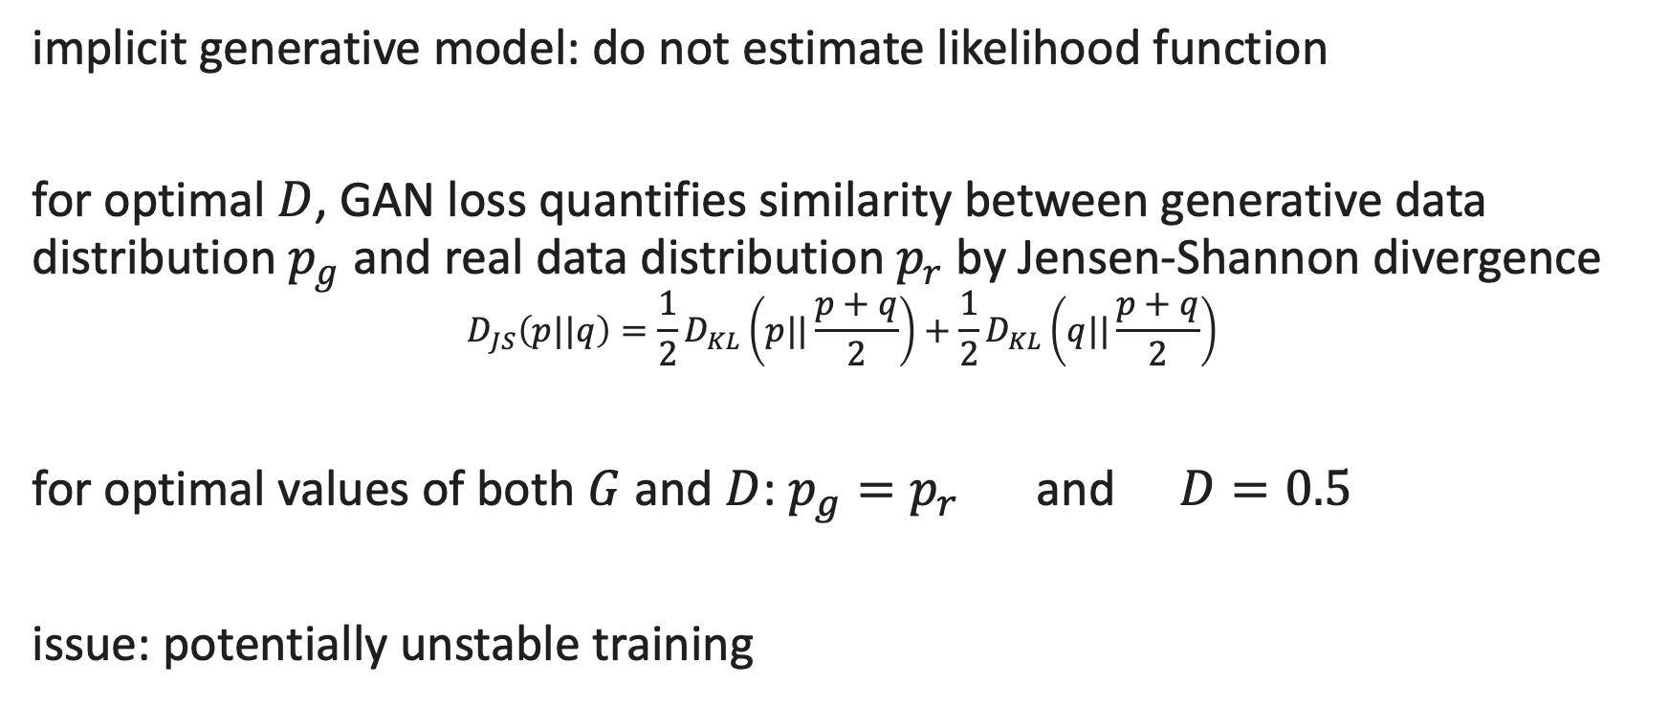
Properties
implicit generative model: do not estimate likelihood function
for optimal $D$, GAN loss quantifies similarity between generative data distribution $p_{g}$ and real data distribution $p_{r}$ by Jensen-Shannon divergence
$$D_{JS}\left(p||q\right)=\frac{1}{2}D_{KL}\left(p||\frac{p+q}{2}\right)+\frac{1}{2}D_{KL}\left(q||\frac{p+q}{2}\right)$$
for optimal values of both $G$ and $D$: $p_{g}=p_{r}$ and $D=0.5$
issue: potentially unstable training

Slide 16
Variational Autoencoders (VAE)

Slide 17

Recap: Autoencoder
(deep) encoder network
(deep) decoder network
learned together by minimizing differences between original input and reconstructed input (expressed as losses)
compressed intermediate representation: dimensionality reduction
source

Slide 18

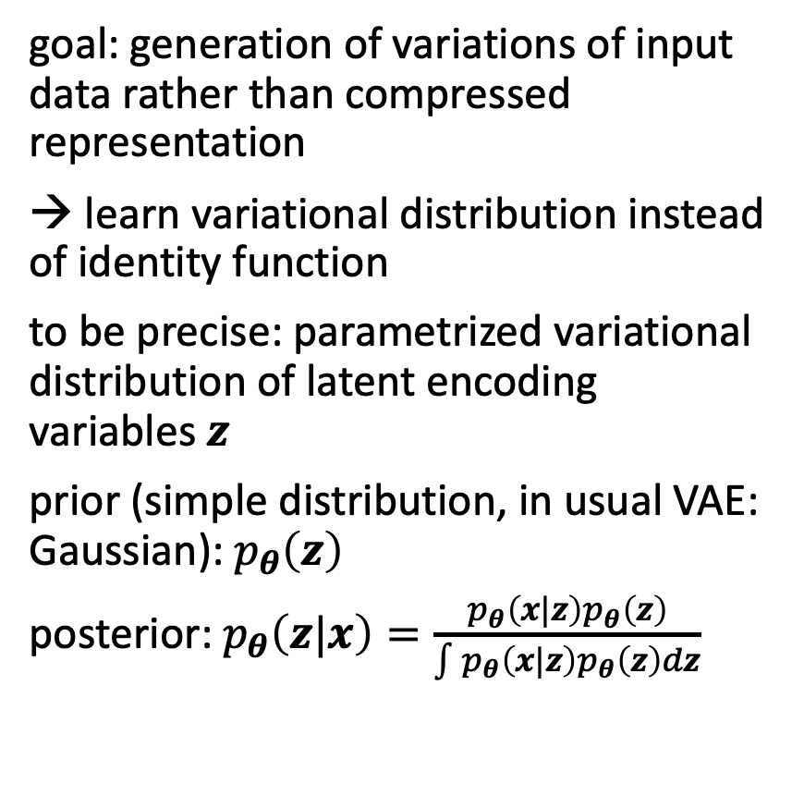
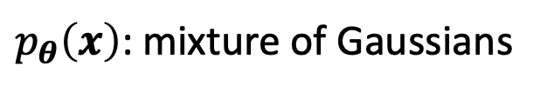
Autoencoder Architecture for Generative Tasks
goal: generation of variations of input data rather than compressed representation
→ learn variational distribution instead of identity function
to be precise: parametrized variational distribution of latent encoding variables $z$
prior (simple distribution, in usual VAE: Gaussian): $p_{θ}\left(z\right)$
posterior: $p_{θ}\left(z|x\right)=\frac{p_{θ}\left(x|z\right)p_{θ}\left(z\right)}{\int{p_{θ}\left(x|z\right)p_{θ}\left(z\right)}dz}$
from which to sample
from wikipedia
Variational Bayesian Method
$p_{θ}\left(x\right)$: mixture of Gaussians

Slide 19

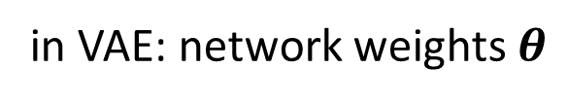

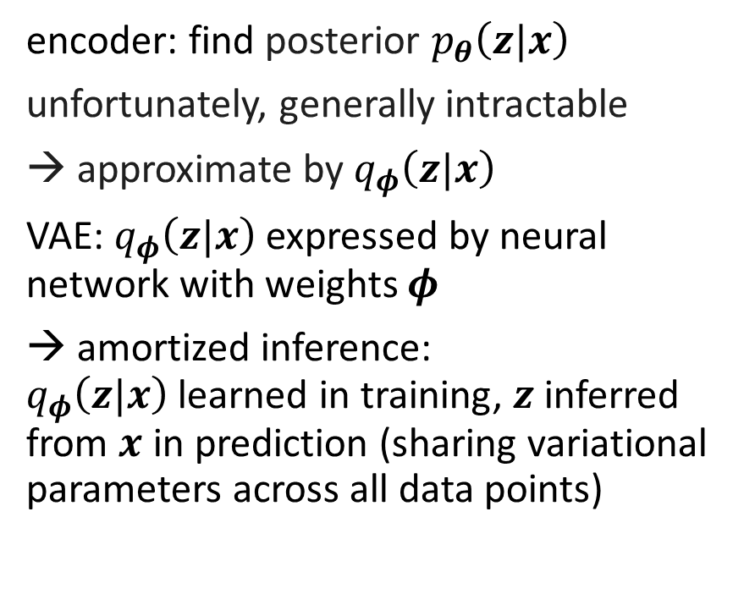
Encoder and Decoder Networks
encoder: find posterior $p_{θ}\left(z|x\right)$
unfortunately, generally intractable
→ approximate by $q_{φ}\left(z|x\right)$
VAE: $q_{φ}\left(z|x\right)$ expressed by neural network with weights $φ$
→ amortized inference: $q_{φ}\left(z|x\right)$learned in training, $z$ inferred from $x$ in prediction (sharing variational parameters across all data points)
decoder: generate new sample $x_{i}$
sample $z_{i}$ (from Gaussian)
generate $x_{i}$ (similar to real data)
→ maximize: $p_{θ}\left(x_{i}\right)=\int{p_{θ}\left(x_{i}|z\right)}p_{θ}\left(z\right)dz$
(integral over $z$ expensive → use only likely codes $z$ given input $x$: need for encoder)
encoder network
decoder network
in VAE: network weights $θ$
source

Slide 20
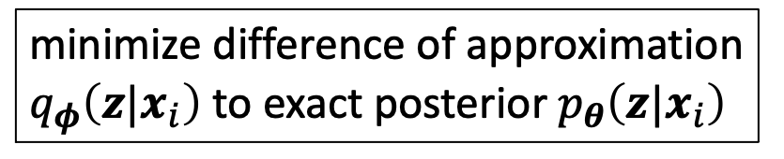
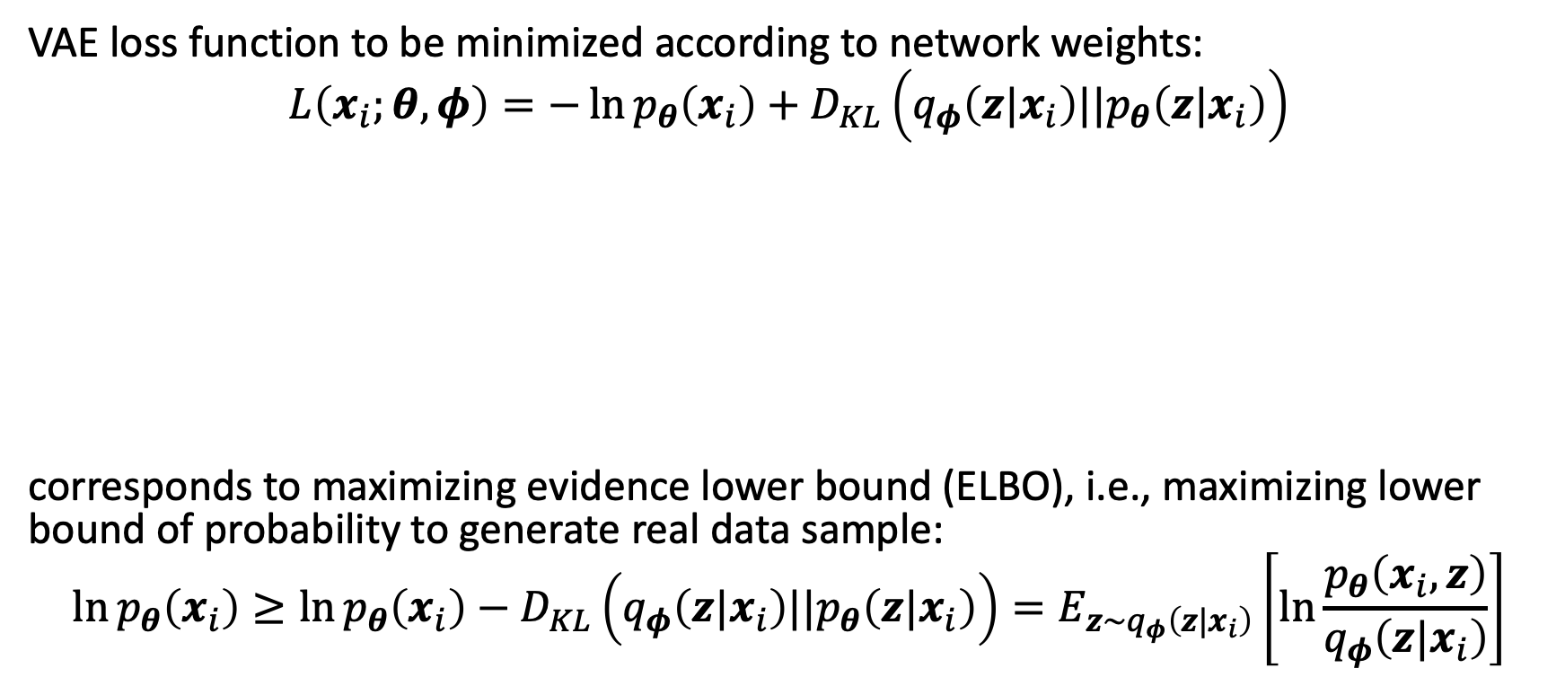
VAE Loss: ELBO
VAE loss function to be minimized according to network weights:
$$L\left(x_{i};θ,φ\right)=−\ln{p_{θ}\left(x_{i}\right)+D_{KL}\left(q_{φ}\left(z|x_{i}\right)||p_{θ}\left(z|x_{i}\right)\right)}$$
corresponds to maximizing evidence lower bound (ELBO), i.e., maximizing lower bound of probability to generate real data sample:
$$\ln{p_{θ}\left(x_{i}\right)}≥\ln{p_{θ}\left(x_{i}\right)−D_{KL}\left(q_{φ}\left(z|x_{i}\right)||p_{θ}\left(z|x_{i}\right)\right)}=E_{z\sim q_{φ}\left(z|x_{i}\right)}\left[\ln{\frac{p_{θ}\left(x_{i},z\right)}{q_{φ}\left(z|x_{i}\right)}}\right]$$
maximize likelihood of observed data (minimize reconstruction error)
minimize difference of approximation $q_{φ}\left(z|x_{i}\right)$ to exact posterior $p_{θ}\left(z|x_{i}\right)$
and
can be interpreted as regularizer
non-negative

Slide 21

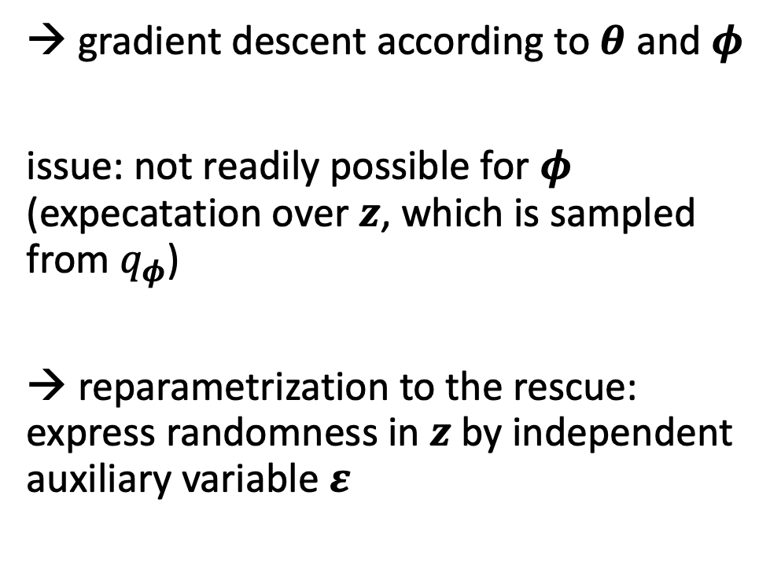
Reparameterization Trick
→ gradient descent according to $θ$ and $φ$
issue: not readily possible for $φ$ (expecatation over $z$, which is sampled from $q_{φ}$)
→ reparametrization to the rescue: express randomness in $z$ by independent auxiliary variable $ε$
from wikipedia

Slide 22

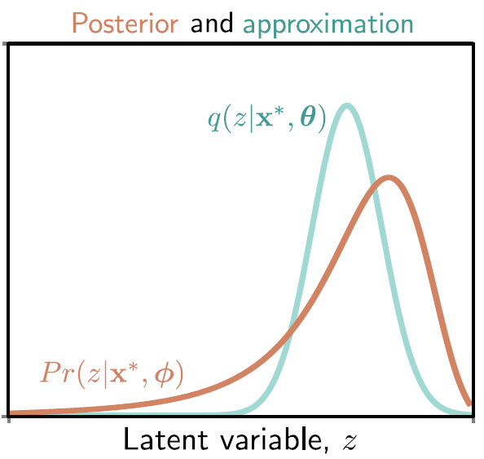
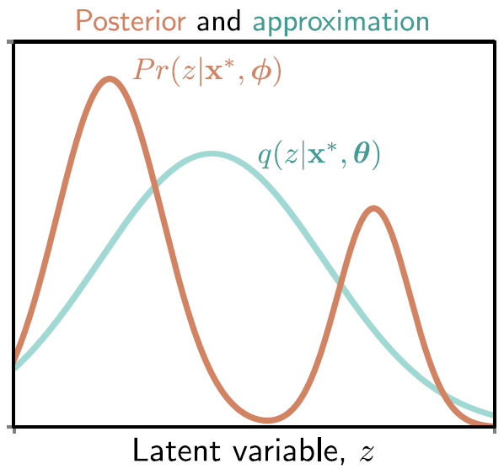
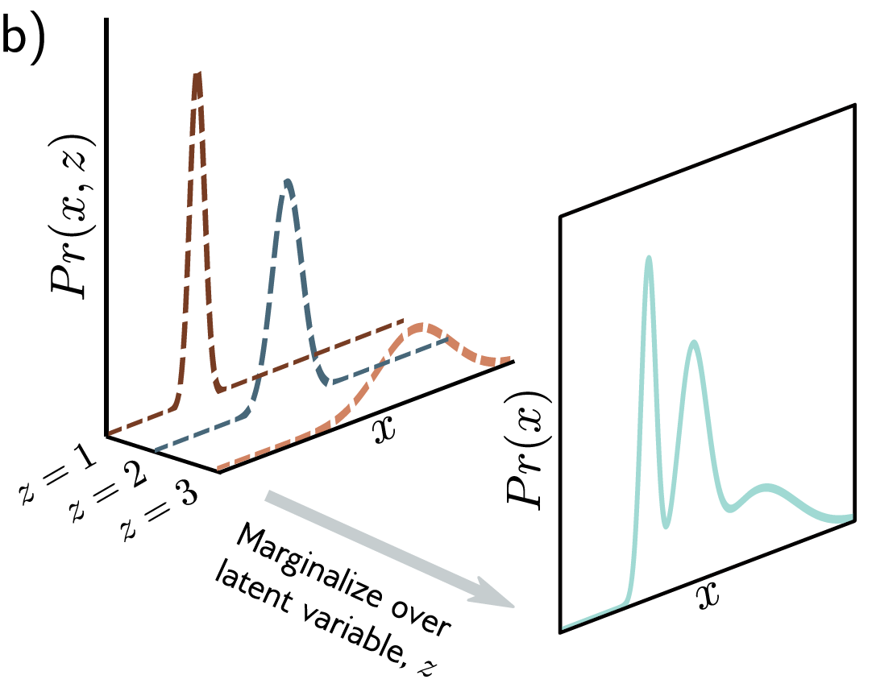
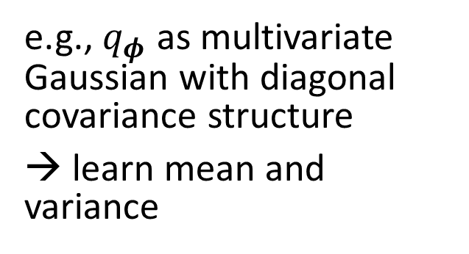
Gaussian Approximation
e.g., $q_{φ}$ as multivariate Gaussian with diagonal covariance structure
→ learn mean and variance
from wikipedia
good approximation:
poor approximation:
source

Slide 23
Flow-Based Methods

Slide 24

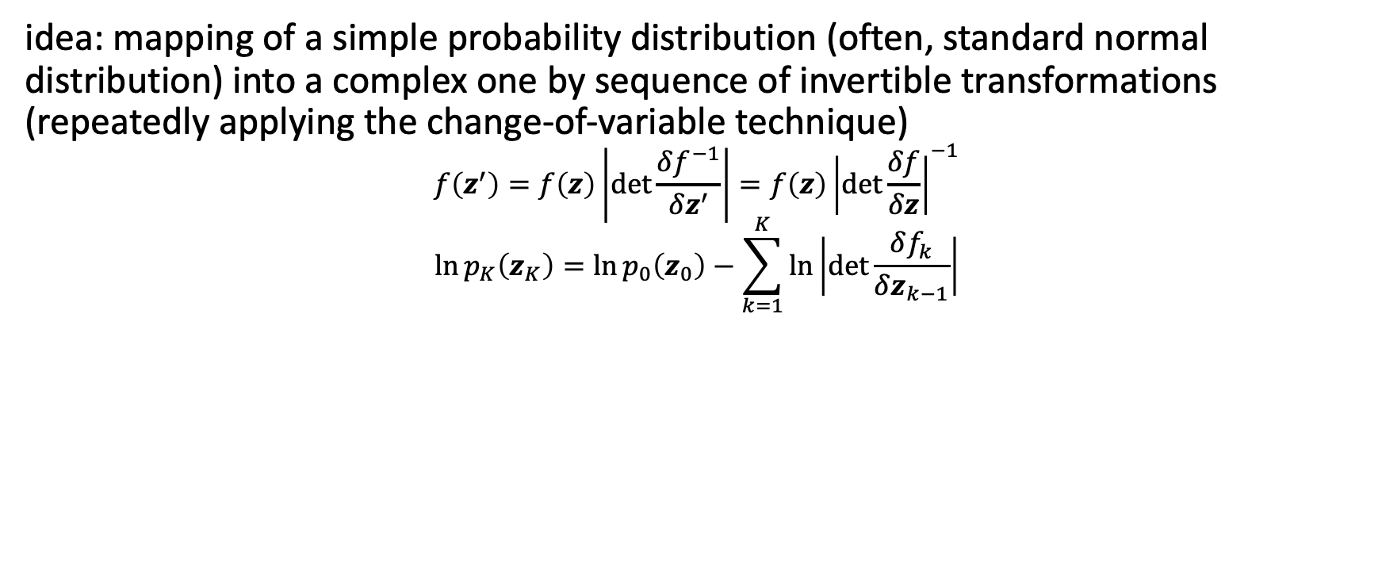

Normalizing Flows
idea: mapping of a simple probability distribution (often, standard normal distribution) into a complex one by sequence of invertible transformations (repeatedly applying the change-of-variable technique)
$$f\left(z^{′}\right)=f\left(z\right)\left|\det{\frac{δf^{−1}}{δz^{′}}}\right|=f\left(z\right){\left|det\frac{δf}{δz}\right|}^{−1}$$
$$\ln{p_{K}\left(z_{K}\right)}=\ln{p_{0}\left(z_{0}\right)}−\sum_{k=1}^{K}{\ln\left|\det{\frac{δf_{k}}{δz_{k−1}}}\right|}$$
log-likelihood:
flow
normalizing flow
$$⋯$$
source

Slide 25
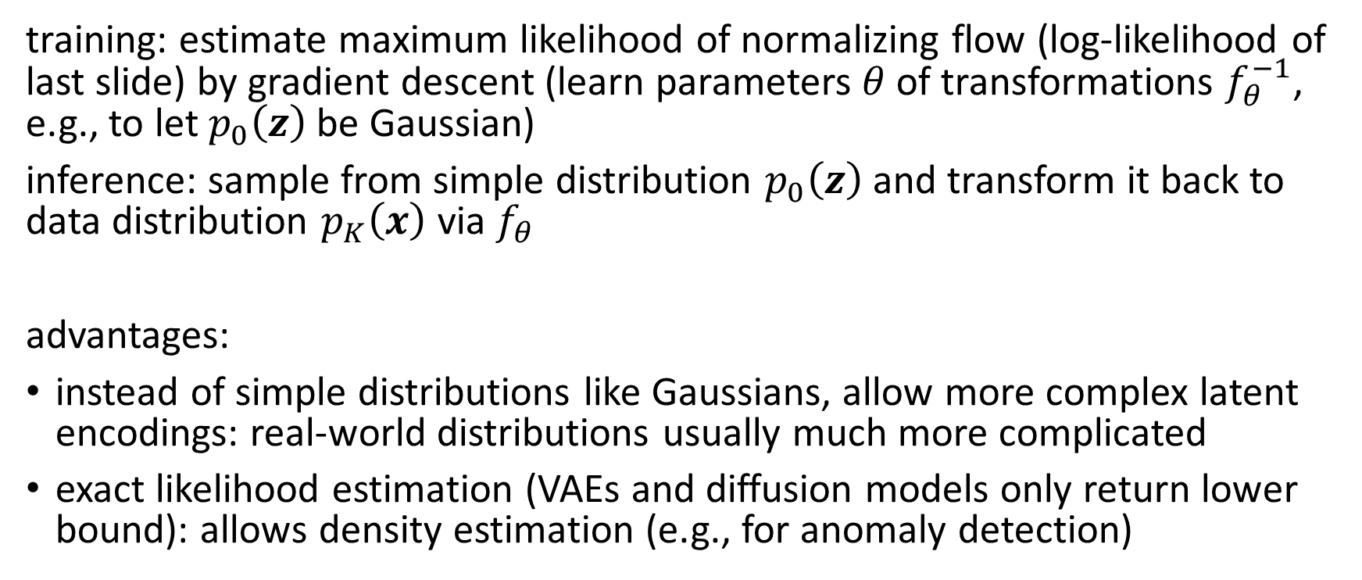
Usage in Generative Models
training: estimate maximum likelihood of normalizing flow (log-likelihood of last slide) by gradient descent (learn parameters $θ$ of transformations $f_{θ}^{−1}$, e.g., to let $p_{0}\left(z\right)$be Gaussian)
inference: sample from simple distribution $p_{0}\left(z\right)$and transform it back to data distribution $p_{K}\left(x\right)$ via $f_{θ}$
advantages:
instead of simple distributions like Gaussians, allow more complex latent encodings: real-world distributions usually much more complicated
exact likelihood estimation (VAEs and diffusion models only return lower bound): allows density estimation (e.g., for anomaly detection)

Slide 26
Invertible Neural Networks
neural networks representing invertible/bijective functions can be used for normalizing flow transformations
forward transformation to generate samples
backward transformation to evaluate likelihoods
need for specialized architectures to construct reversible transform (e.g., affine coupling layers)

Slide 27
Diffusion Models

Slide 28
Idea
training: distort training data by successively adding random noise, then learn to reverse this process (denoising)
generation: sample random noise and run through the learned denoising process
advantages: easy to train, produce high-quality/realistic samples
can be interpreted as special case of hierarchical VAE (one latent variable generates another) with fixed encoder and latent space of same size as the data → more sophisticated latent space than just Gaussian mixture in VAE

Slide 29
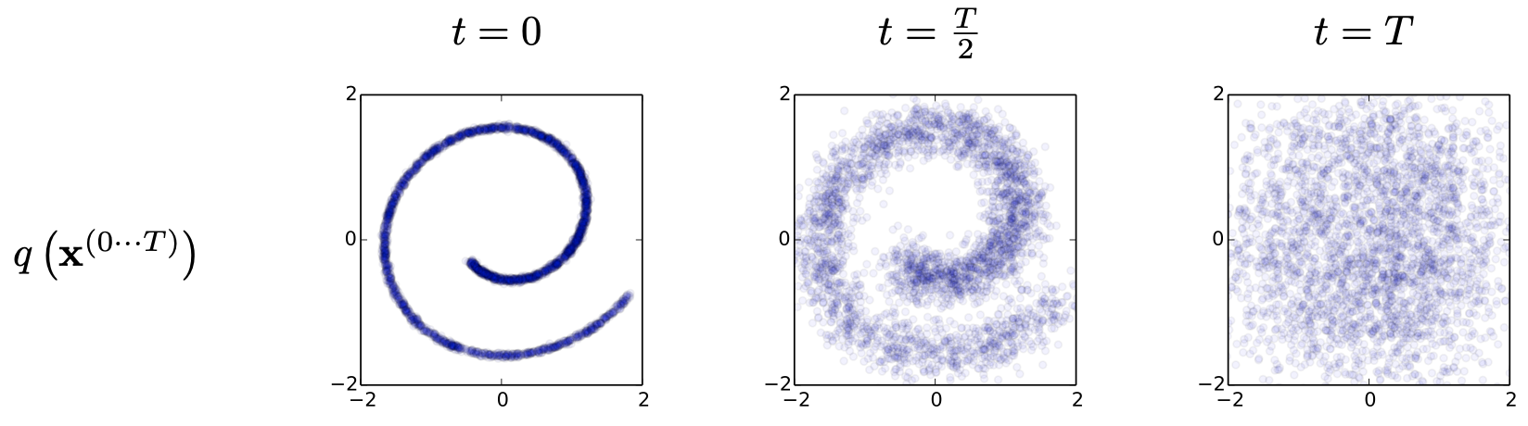
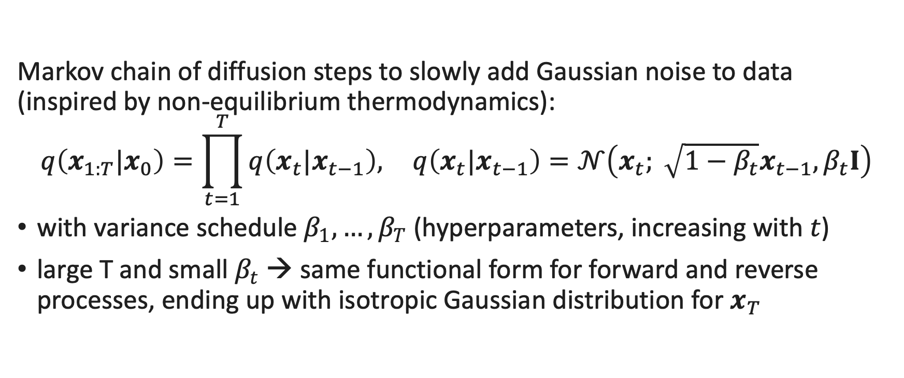
Forward Process
Markov chain of diffusion steps to slowly add Gaussian noise to data (inspired by non-equilibrium thermodynamics):
$$q\left(x_{1:T}|x_{0}\right)=\prod_{t=1}^{T}{q\left(x_{t}|x_{t−1}\right),} q\left(x_{t}|x_{t−1}\right)=𝒩\left(x_{t}; \sqrt{1−β_{t}}x_{t−1}, β_{t}I\right)$$
with variance schedule ${β_{1}, …, β}_{T}$ (hyperparameters, increasing with $t$)
large T and small $β_{t}$ → same functional form for forward and reverse processes, ending up with isotropic Gaussian distribution for $x_{T}$
source

Slide 30
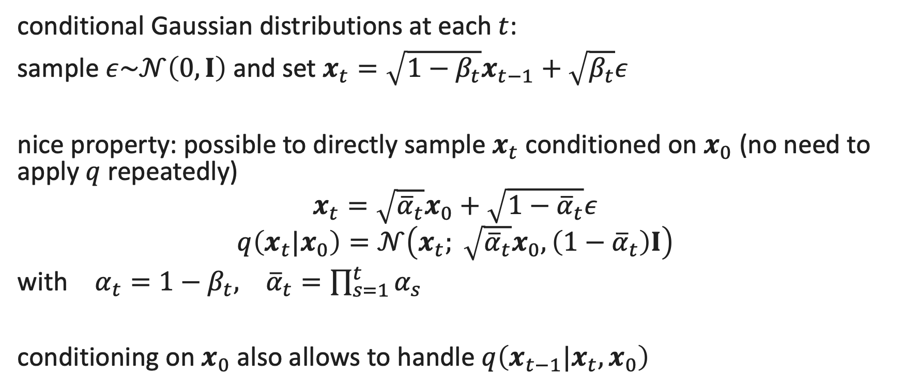
Reparametrization
conditional Gaussian distributions at each $t$:
sample $ε\sim 𝒩\left(0,I\right)$ and set $x_{t}=\sqrt{1−β_{t}}x_{t−1}+\sqrt{β_{t}}ε$
nice property: possible to directly sample $x_{t}$ conditioned on $x_{0}$ (no need to apply $q$ repeatedly)
$$x_{t}=\sqrt{{\overline{α}}_{t}}x_{0}+\sqrt{{1−\overline{α}}_{t}}ε$$
$$q\left(x_{t}|x_{0}\right)=𝒩\left(x_{t}; \sqrt{{\overline{α}}_{t}}x_{0},\left(1−{\overline{α}}_{t}\right)I\right)$$
with $α_{t}=1−β_{t}, {\overline{α}}_{t}=\prod_{s=1}^{t}{α_{s}}$
conditioning on $x_{0}$ also allows to handle $q\left(x_{t−1}|x_{t},x_{0}\right)$

Slide 31

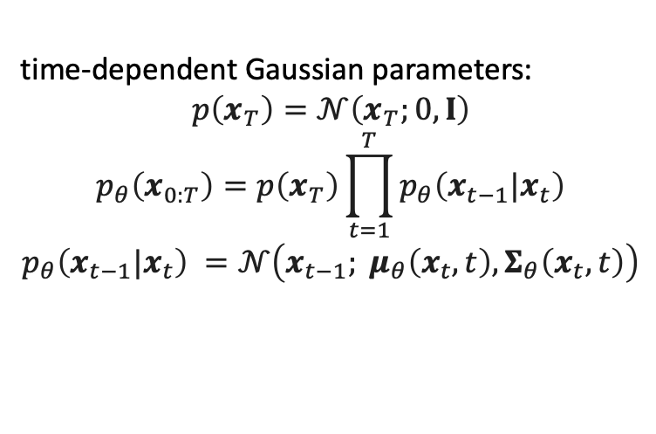

Reverse Process
to generate new data samples, one needs to learn to reverse the diffusion process (starting from pure noise): neural network learning to gradually denoise data
overall loss as sum of losses for each time step $t$
for each $t$: $D_{KL}$ between two Gaussians (closed form) $q\left(x_{t−1}|x_{t},x_{0}\right)$ and $p_{θ}\left(x_{t−1}|x_{t}\right)$
→ corresponds to VAE loss: maximizing ELBO
time-dependent Gaussian parameters:
$$p\left(x_{T}\right)=𝒩\left(x_{T};0,I\right)$$
$$p_{θ}\left(x_{0:T}\right)=p\left(x_{T}\right)\prod_{t=1}^{T}{p_{θ}\left(x_{t−1}|x_{t}\right)}$$
$$p_{θ}\left(x_{t−1}|x_{t}\right) =𝒩\left(x_{t−1}; μ_{θ}\left(x_{t},t\right),Σ_{θ}\left(x_{t},t\right)\right)$$
source

Slide 32
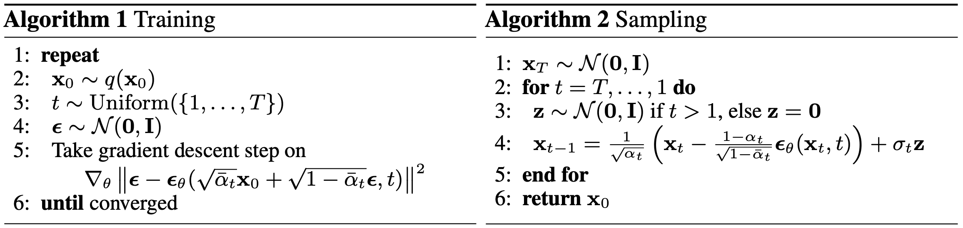

Noise Prediction
reparametrization allows to learn added noise instead of Gaussian parameters:
L2-loss (MSE) between true and predicted Gaussian noise at time step $t$
use position embeddings (as network parameters are shared across time)
diffusion models can be interpreted as chain of denoising autoencoders (also connected to score-based generative modeling via Langevin dynamics)
source

Slide 33

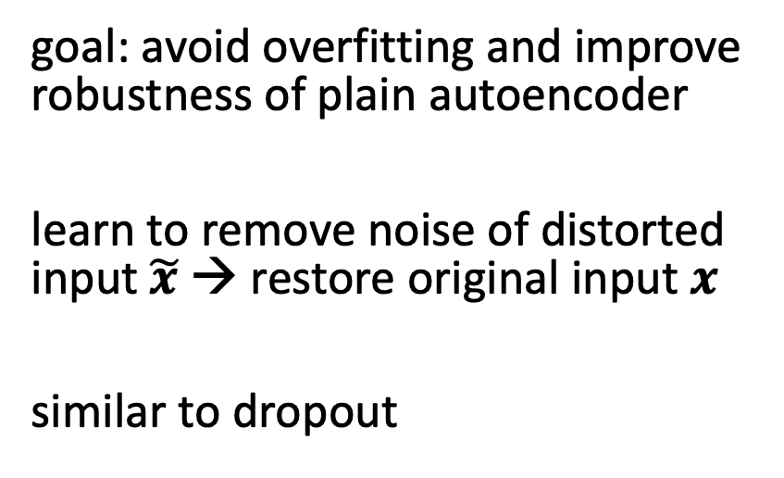
Denoising Autoencoder
goal: avoid overfitting and improve robustness of plain autoencoder
learn to remove noise of distorted input $\tilde{x}$ → restore original input $x$
similar to dropout
source
differences of diffusion models to typical denoising autoencoders:
no bottleneck (care about output here, not internal representation): latent space with high dimensionality (same as original data)
handle many different noise levels with single set of shared parameters

Slide 34
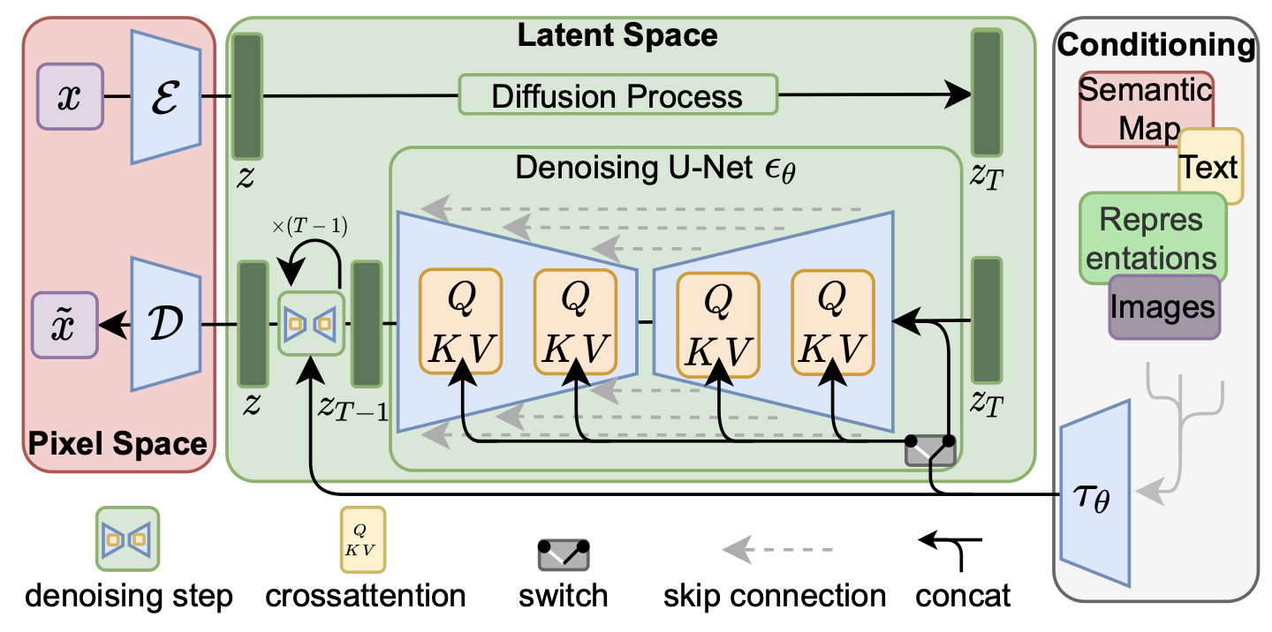
Latent Diffusion Model
add noise to latent representation rather than raw data
→ significant speedup
diffusion models highly flexible in terms of architecture: only require same input and output dimensionality (autoencoder-like)
often, (convolutional) U-Net architectures (skip connections)
but also (vision) transformers possible (e.g., DiT)
source
use of attention mechanism for flexible conditioning

Slide 35
Conditioned Generation

Slide 36

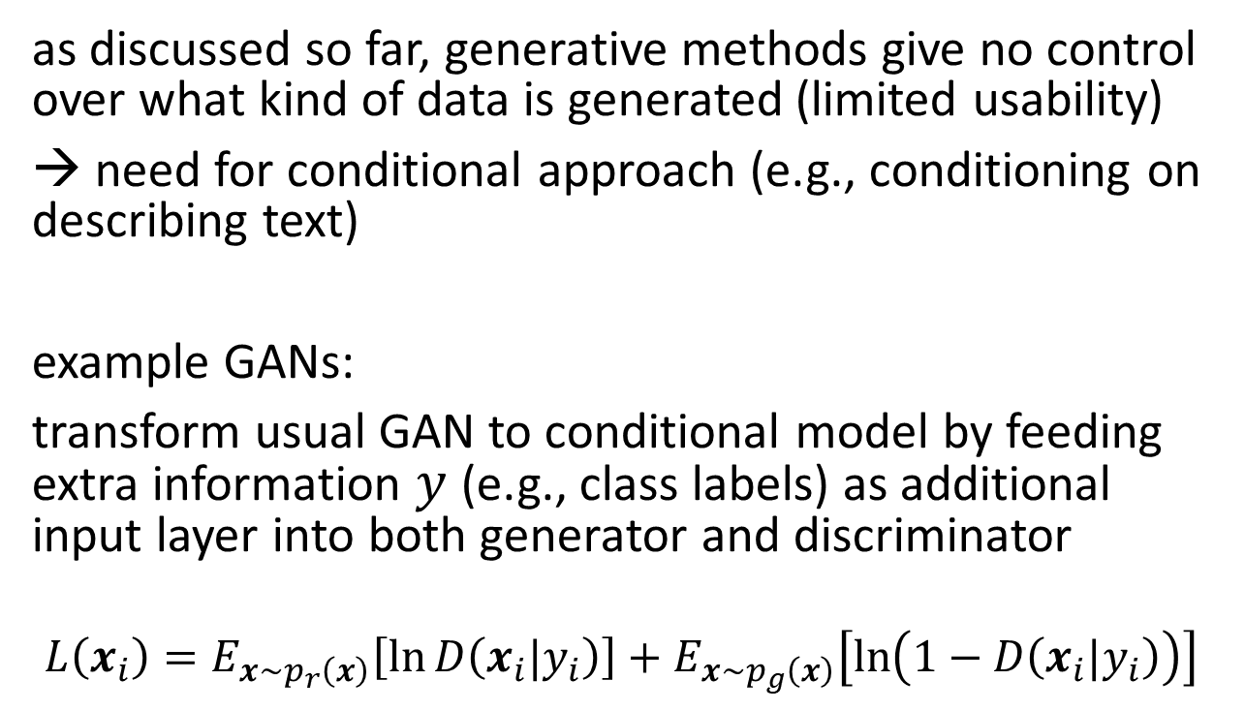
Conditional GANs
as discussed so far, generative methods give no control over what kind of data is generated (limited usability)
→ need for conditional approach (e.g., conditioning on describing text)
example GANs:
transform usual GAN to conditional model by feeding extra information $y$ (e.g., class labels) as additional input layer into both generator and discriminator
$$L\left(x_{i}\right)=E_{x\sim p_{r}\left(x\right)}\left[\ln{D\left(x_{i}|y_{i}\right)}\right]+E_{x\sim p_{g}\left(x\right)}\left[\ln\left(1−D\left(x_{i}|y_{i}\right)\right)\right]$$
source

Slide 37

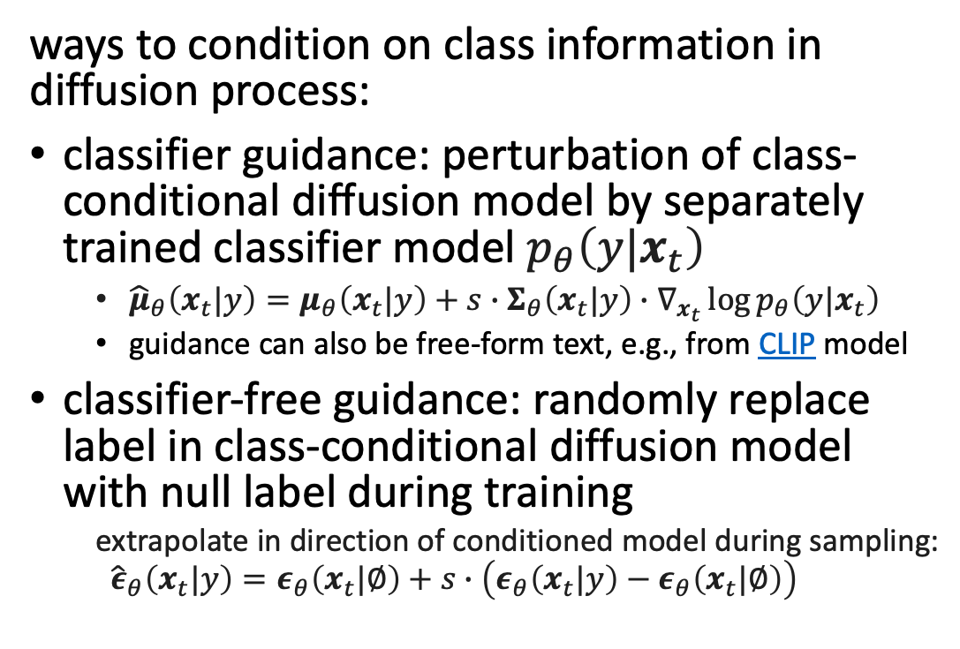
Guided Diffusion
similar idea as softmax temperature in auto-regressive LLMs
ways to condition on class information in diffusion process:
classifier guidance: perturbation of class-conditional diffusion model by separately trained classifier model $p_{θ}\left(y|x_{t}\right)$
${\hat{μ}}_{θ}\left(x_{t}|y\right)=μ_{θ}\left(x_{t}|y\right)+s∙Σ_{θ}\left(x_{t}|y\right)∙∇_{x_{t}}\log{p_{θ}\left(y|x_{t}\right)}$
guidance can also be free-form text, e.g., from CLIP model
classifier-free guidance: randomly replace label in class-conditional diffusion model with null label during training
extrapolate in direction of conditioned model during sampling:
$${\hat{ε}}_{θ}\left(x_{t}|y\right)=ε_{θ}\left(x_{t}|∅\right)+s∙\left(ε_{θ}\left(x_{t}|y\right)−ε_{θ}\left(x_{t}|∅\right)\right)$$
tradeoff between diversity (unconditioned) and fidelity (guidance)
“Pembroke Welsh corgi”
guidance scale: hyperparameter for tradeoff between sample quality and diversity
source

Slide 38


Text-to-Image
plenty of applications: DALL-E 2, Stable Diffusion, ImageGen, ...
also text-to-speech (e.g., VALL-E), text-to-video (e.g., Make-A-Video), ...
inpainting example (GLIDE ):
web app for Stable Diffusion: DreamStudio
source
prompt

Slide 39
Literature
papers:
variational autoencoder
normalizing flows
GAN
denoising diffusion, latent diffusion

Slide 40


Movie-like Intelligence
emergent capabilities of complex systems difficult to foresee
mini examples in contemporary ML:
large language models
multi-agent reinforcement learning
philosophical: emotions and consciousness in humans may also have occurred as emergent capabilities (But that does not mean the same will happen with AI.)
ideas for paths toward general intelligence:
reward is enough
small-world/scale-free networks

